Slide 1
E-COMMERCE PRODUCT CATEGORIZATION

Slide 2
Table of content
Problem statement
Data Exploration
Feature Engineering
Visualization
Building Model
Model Evaluation
Conclusion

Slide 3
Problem Statement
In the rapidly evolving world of eCommerce, accurate product categorization is crucial for ensuring seamless customer experiences, reducing search friction, and increasing product discoverability. However, the sheer volume of diverse products poses a significant challenge. Current classification systems struggle to handle ambiguities, unconventional naming conventions, and multi-language data. This hackathon aims to address these challenges by inviting participants to create innovative solutions that enhance product categorization efficiency, accuracy, and scalability.
Develop a multi-class text classifier that categorizes products with maximum accuracy based on the given dataset.

Slide 4
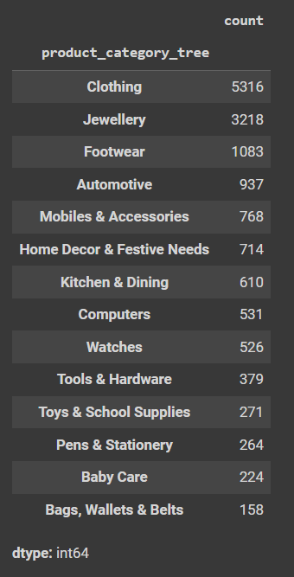
Data Exploration
The dataset contains 14,999 rows and 15 columns including product name, product url, category, description etc.
The product_category_tree is our target variable for classification, which contains hierarchical category information that we need to parse and use for multi-class classification.
This dataset also contains many missing values, and it very important to handle them as missing values can lead to inaccurate data. To handle missing values, I have used dropna (to drop) and fillna (to impute mean/median).
The product_category_tree and Description are the two most important columns to build and predict the results, so dropped the rest unnecessary/non-relevant columns

Slide 5
Feature Engineering
Feature engineering is the process of using domain knowledge to extract or create features (input variables) that make machine learning algorithms work more effectively.
Used TF – IDF (Term Frequency-Inverse Document Frequency) to convert the description text into meaningful features to show how important a word is to a document.
After IF – IDF, we performed Word Embedding (Word2Vec) to capture semantic meanings, and then combined TF-IDF and Word2Vec feature for further use.
For target label, i.e., product_category_tree, Label Encoding is used to convert categorical variables into a numerical format so that they can be effectively used in machine learning algorithms

Slide 6
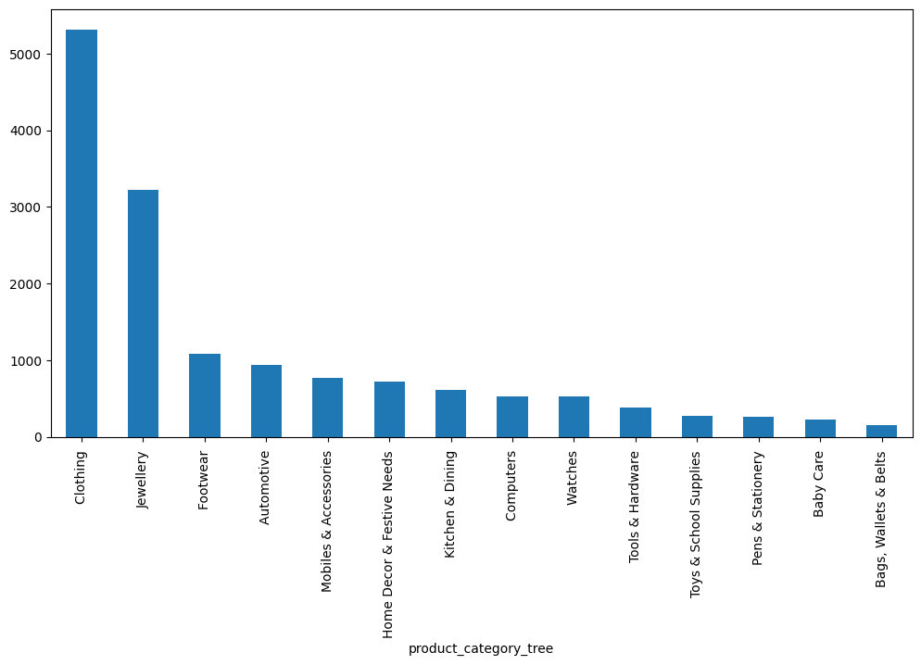
Visualization
Count of each category

Slide 7
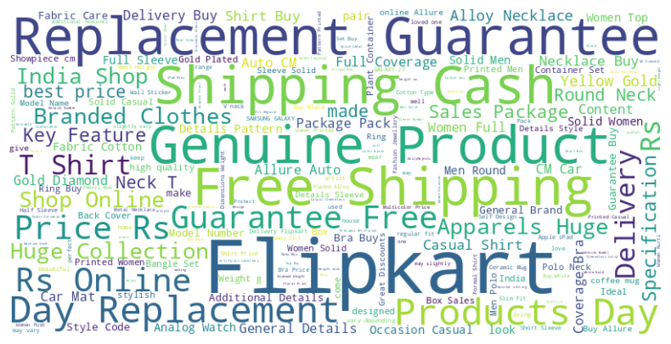
Word clouds are a great way to visualize the frequency of words in text data.
frequency of words for Description column

Slide 8
Building Model
As the dataset is imbalanced, it is necessary for us to handle that before developing the model.
I have used SMOTE (Synthetic Minority Over-sampling Technique) to address class imbalance. It is highly popular, particularly in classification problems.
After SMOTE, I have used Scaling. It is a crucial preprocessing step in machine learning that involves transforming features so they are on a similar scale which leads to equal contribution and enhanced interpretability.
Once our dataset is processed, we will move to model building. Following 5 models are used in this project:
Random Forest Classifier
Extreme Gradient Boosting
Extra Trees Classifier
Logistic Regression

Slide 9


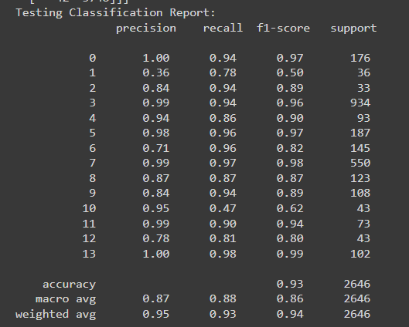
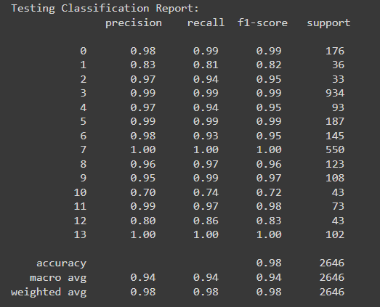
Model Evaluation
1. Random Forest Classifier
2. Extreme Gradient Boosting (XGBoost)

Slide 10


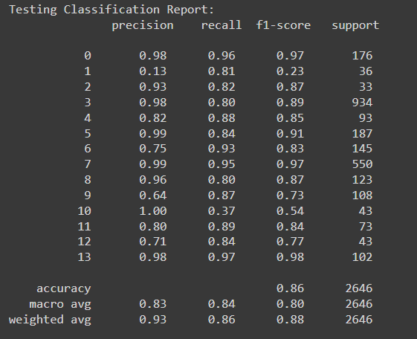
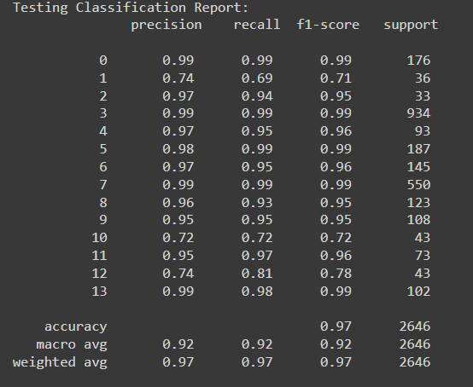
3. Extra Trees Classifier
4. Logistic Regression

Slide 11
Conclusion
MODEL NAME | ACCURACY | PRECISION | RECALL
Xgboost | 97.73% | 0.98 | 0.97
Random Forest Classifier | 93.19% | 0.94 | 0.93
Extra Trees Classifier | 86.09% | 0.92 | 0.86
Logistic Regression | 97.05% | 0.96 | 0.97
As we can predict, XGBoost would fit best for this project (among these 4).

